Slide 1


Slide 2


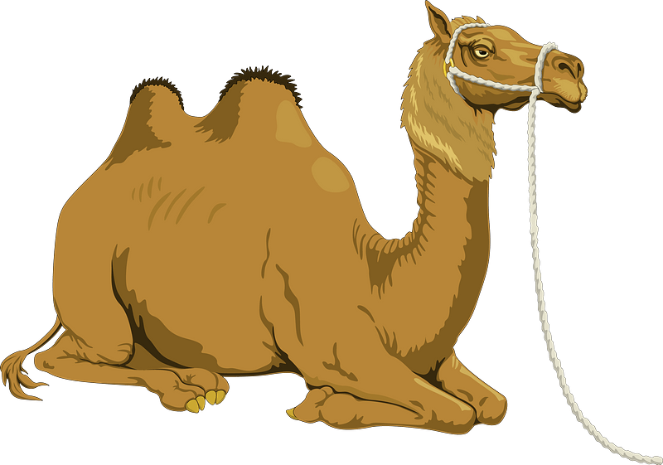
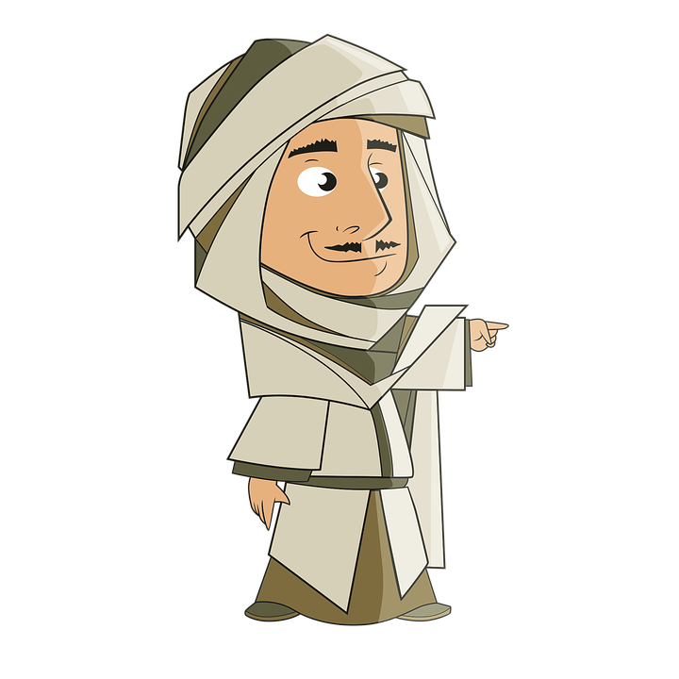
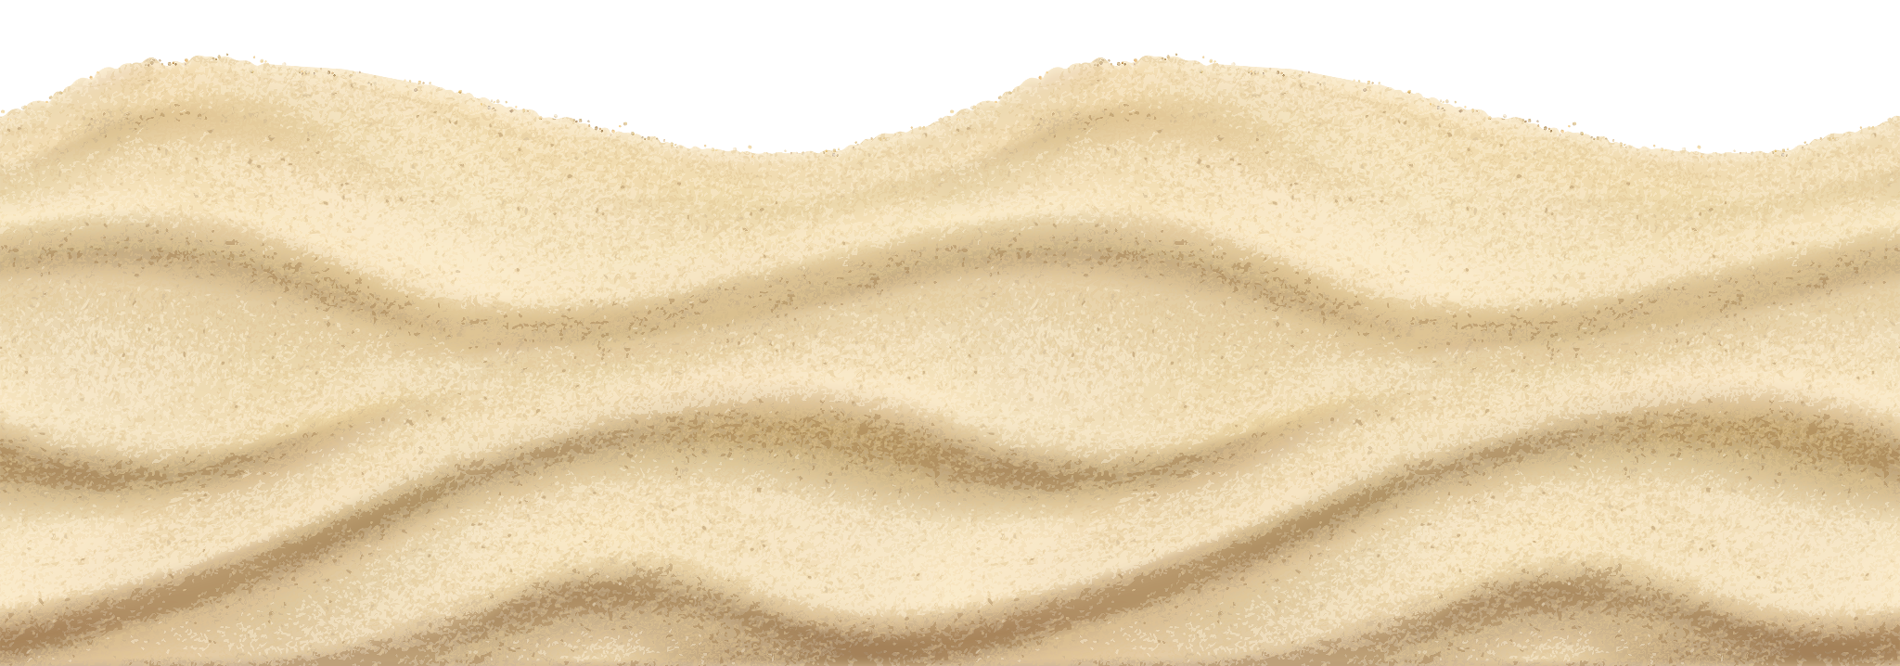
Where is this place?
DESERT

Slide 3

You're lost in the desert. What is your first priority?

Slide 4
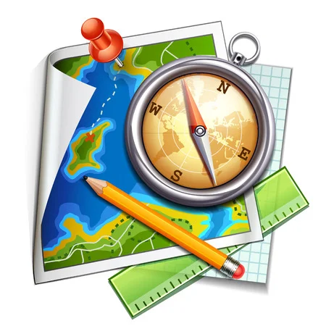
UNIT 6
SURVIVAL
LESSON 4: VOCABULARY AND LISTENING
Survival Equipment

Slide 5


Slide 6

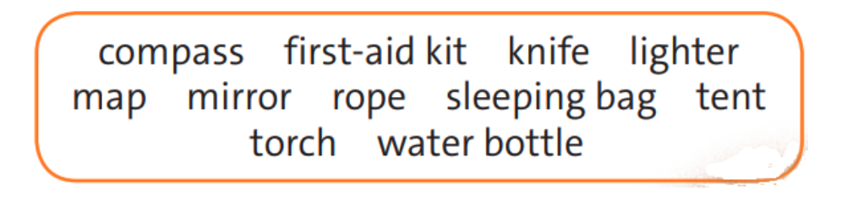
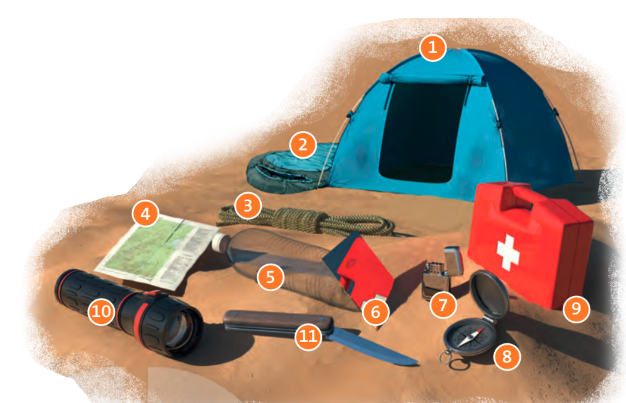
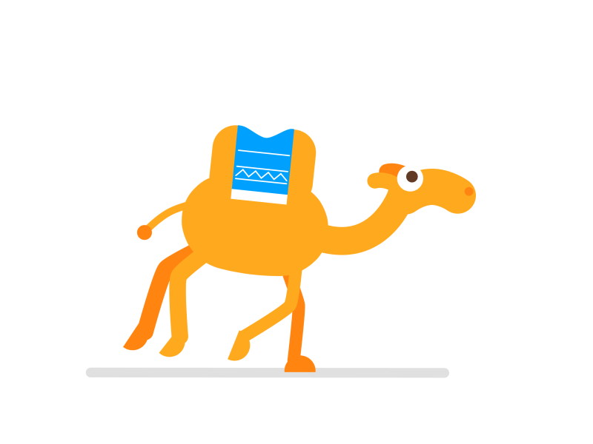
✔ Activity 1: Match objects 1-11 in the picture with the words in the box. Then listen and check.
8
9
11
7
4
6
3
2
1
10
5

Slide 7
I. NEW WORDS:
1. compass (n)
/ˈkʌm.pəs/
la bàn
2. first-aid kit (n)
/ˌfɜːst ˈeɪd ˌkɪt/
hộp sơ cứu
3. torche (n)
/tɔːtʃ/
đèn pin
4. experienced (a)
/ɪkˈspɪə.ri.ənst/
có kinh nghiệm
5. tough (a)
/tʌf/
khắc nghiệt
6. challenge (n)
/ˈtʃæl.ɪndʒ/
thử thách
challenging (a)
/ˈtʃæl.ɪn.dʒɪŋ/
đầy thách thức

Slide 8
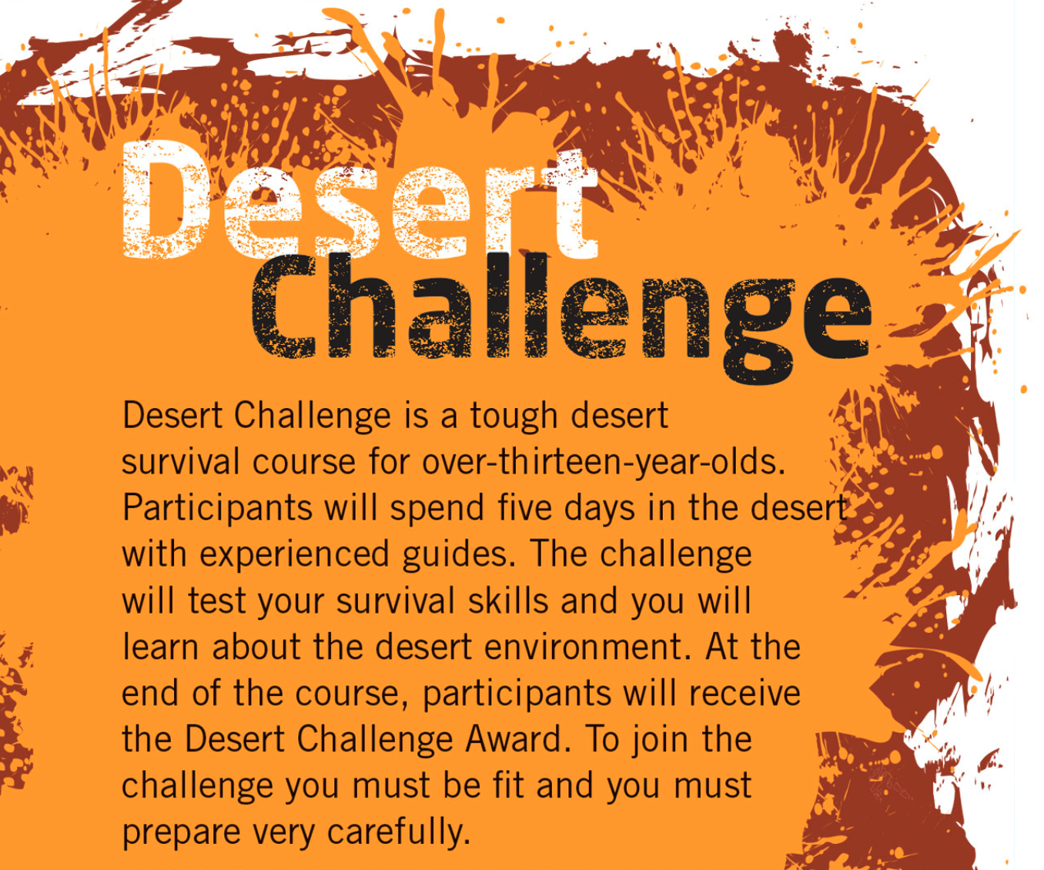
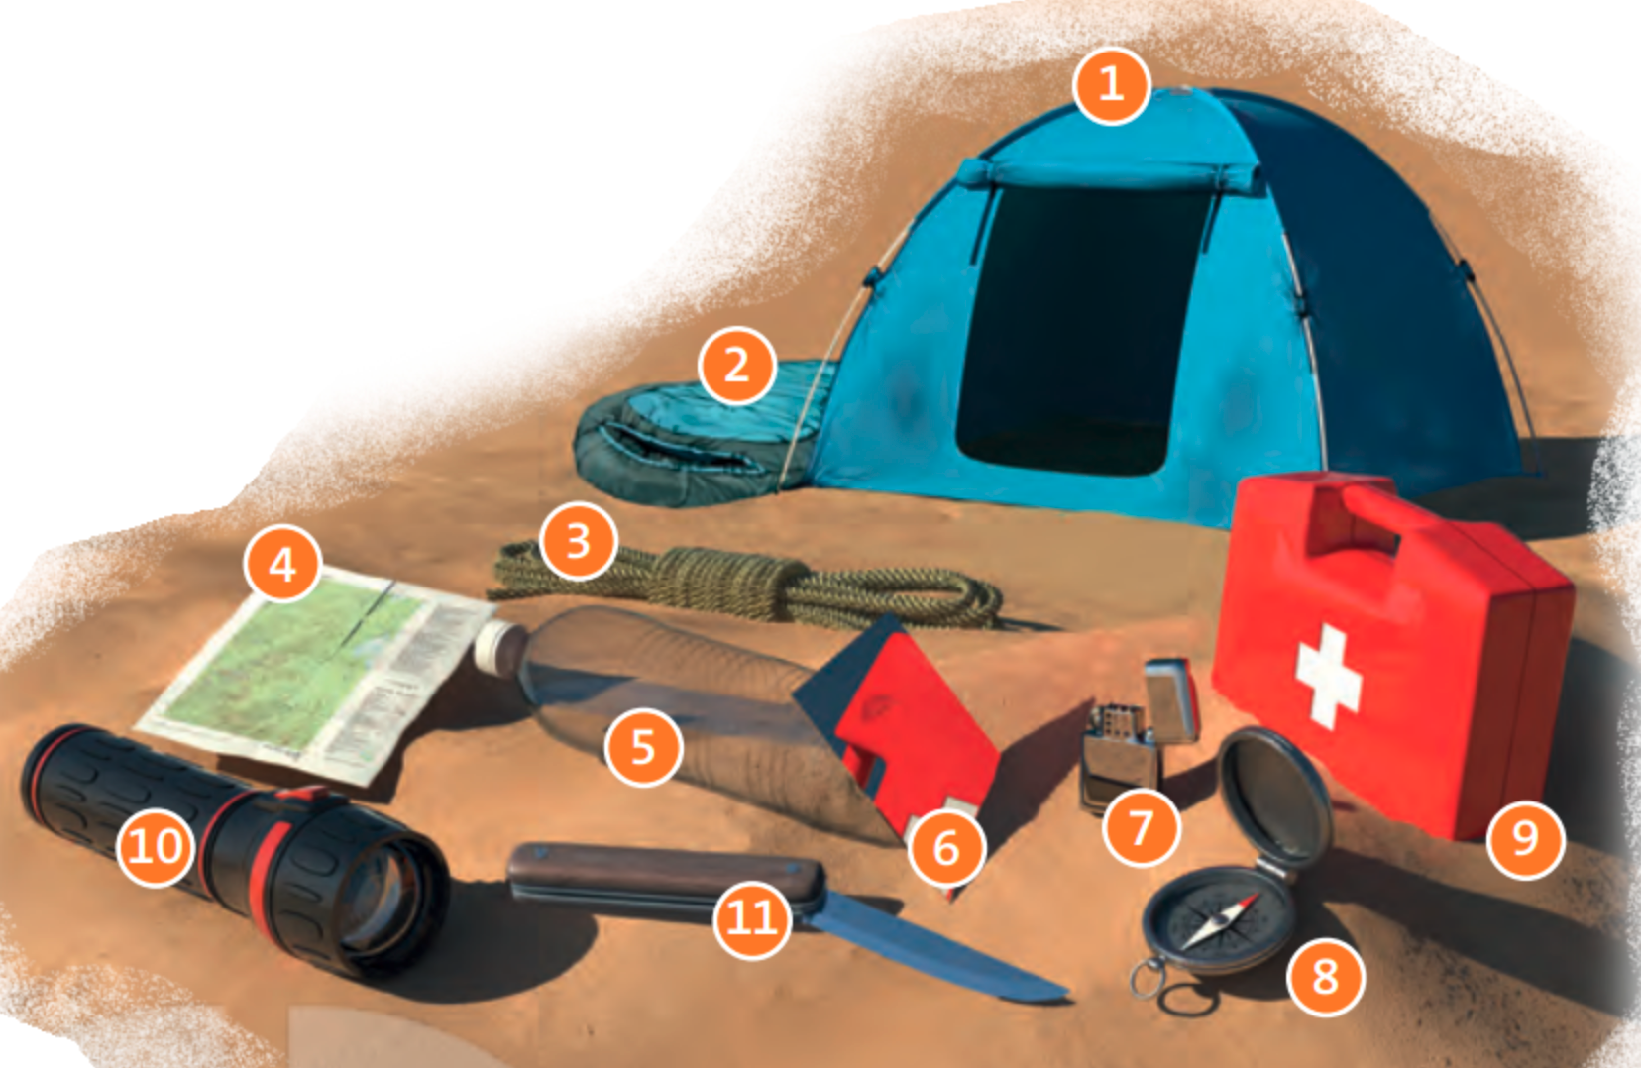
✔ Activity 2: Read the introduction to Desert Challenge. Which objects in exercise 1 will people probably need on a desert trek?

Slide 9
✔ Activity 3: Listen to Kay Freeman talking about the survival course she went on. Which equipment from exercise 1 does she say is useful?

Slide 10
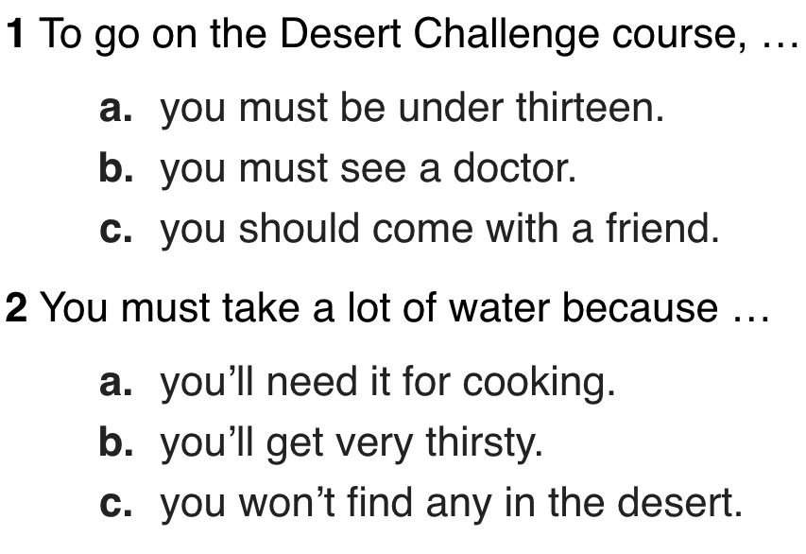
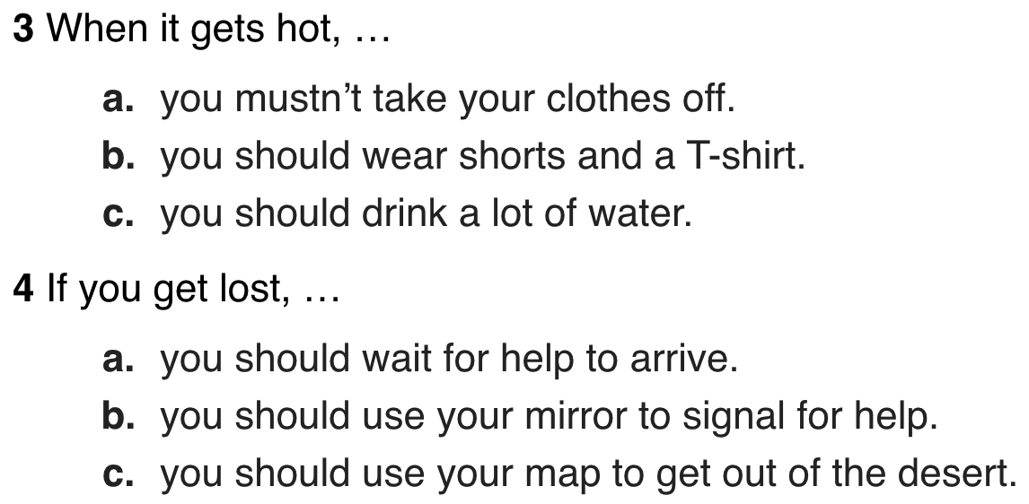
✔ Activity 4: Read and listen to the text and complete the sentences with the name of a team member

Slide 11


Slide 12
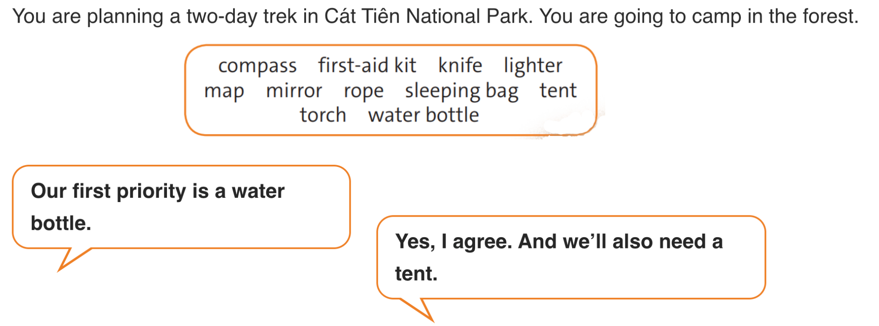
✔ Activity 5: Work in pairs. Say which objects from exercise 1 are the most useful for survival in this situation and why. Agree on five objects.

Slide 13

- Learn by heart all the new words.
- Workbook: Exercises p.
- Prepare Lesson 5 – Language Focus

Slide 14


